Slide 1


The Big 5.
Group members:
Tshiamo Khosana
Uyazi Yako
Lathitha Nongauza
Anda Gwele
Luphumlo Hamla

Slide 2
The Game Proposal.
The Plan:
Our plan to make our App to have 4 games on it.
These four games include, Tic Tac Toe, Sudoku, A Math Game, and a Quote game.
If we had much more time we would make our App to have many game, but the things time is not on our side.
We are also trying to make our Game App to have a smooth, calming sound playing on the background when you are playing the games that are on it.

Slide 3
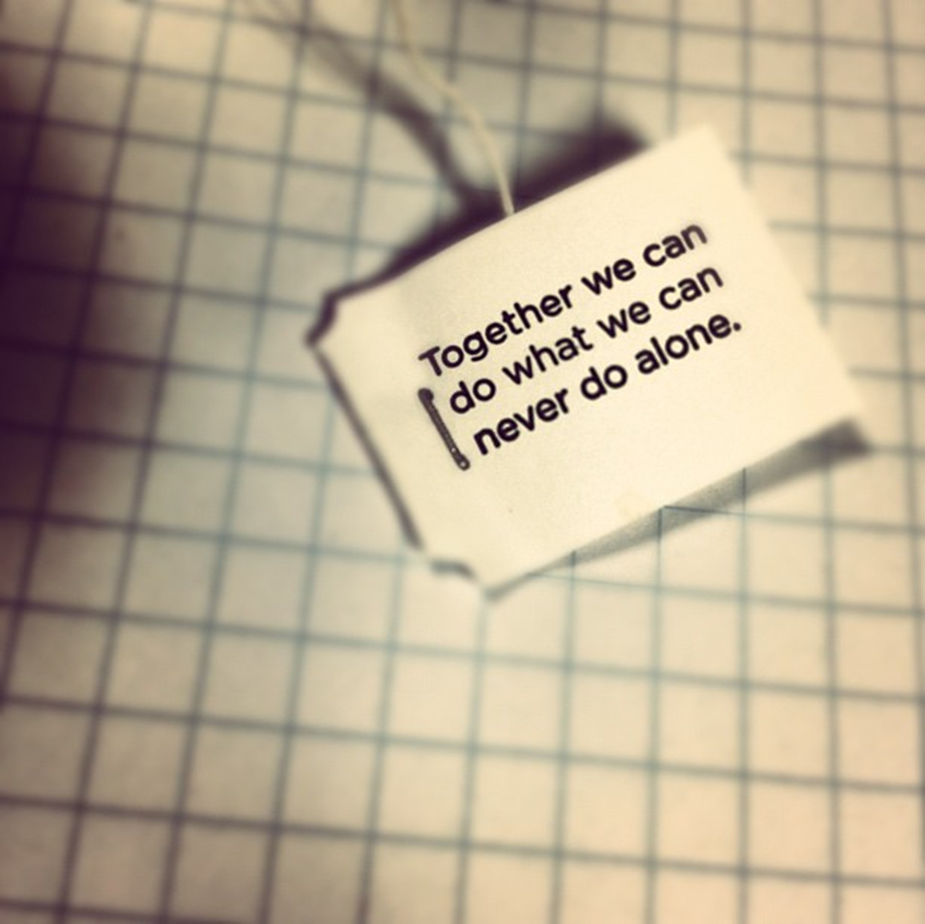
Challenges:
As expected we will face some challenges when we are doing this gaming App, because most of us this is our first time using Android studios.
The other challenge that will face is making the game to run smooth, without giving the user some minor problems because we are new on android studios
Creating a game and running it on command prompt is not a huge problem, but linking that code to android studios will be a challenge for us, because we have to make sure that we have created linkable buttons that run smooth there.
Solutions:
These challenge that we are going to have, we will face them as a team, because we believe that by working as a team we can conquer anything.
We will try our best to make this Gaming App come to life.
Motivating each and believing to ourselves is the key of making this game to come to life.

Slide 4
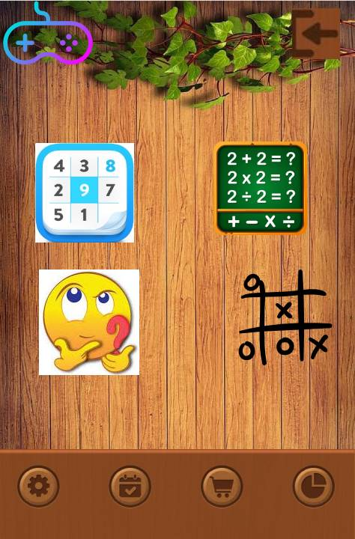
This is how the App will look like:
This is the home page, it has all the games that we are going to do.

Slide 5
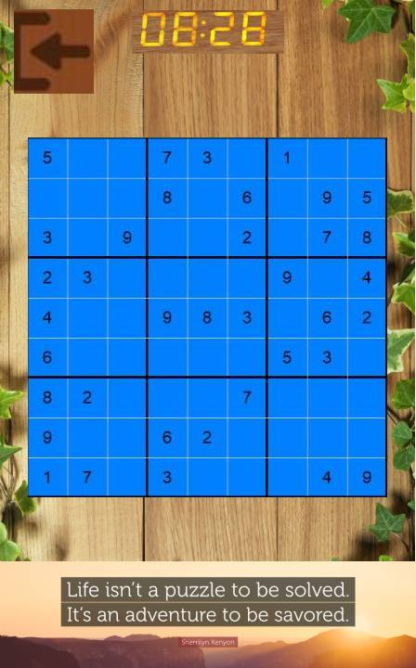
This is sudoku

Slide 6
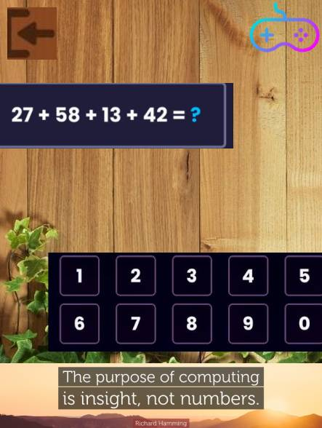
This is the Math:
how it works:
It displays an equation then the user have to solve that equation

Slide 7
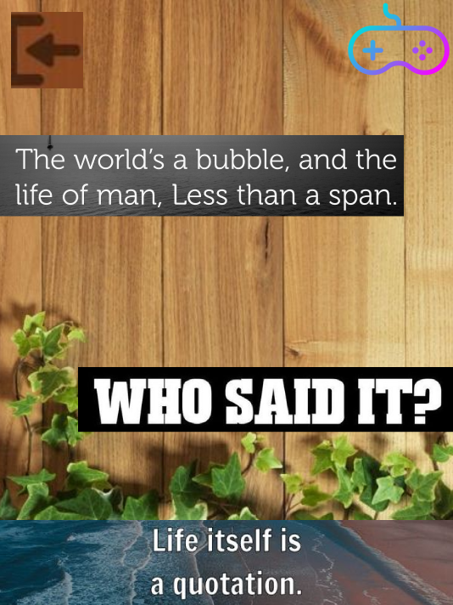
This is the quote game :
How it works:
It display a quote then you have to choose the name of the person who came up with the quote.

Slide 8
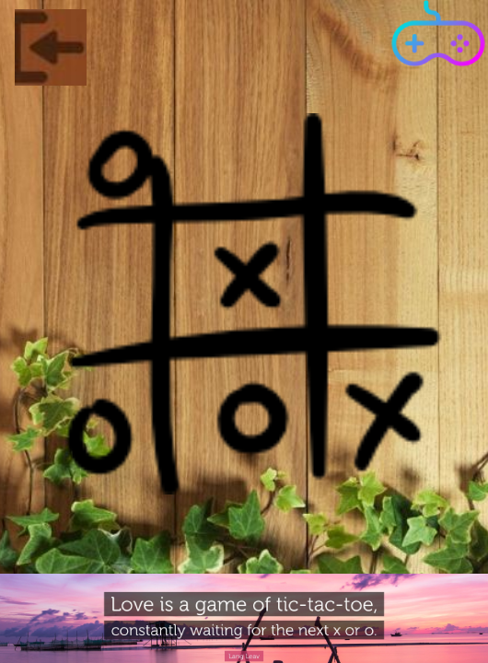
Tic Tac Toe game

Slide 9
We do have other files which include our algorithms but we are not sure if they are needed

